Slide 1
A Quick Tour around MVC Core
Chapter 13

Slide 2
Chapter Overview
Objectives
Gain an overview of an MVC application
Chapter content
The MVC Pattern
Models, Views, and Controllers
ASP.NET MVC Conventions
MVC Project structure
Visual Studio support
Exercise
Create an ASP.NET MVC project in Visual Studio

Slide 3
What is the MVC Design Pattern
An architectural pattern that can be used when developing interactive applications.
Uses the principle of “Separation of Concerns”
Enhancing maintainability, extensibility, and testability
Separates interaction logic into three areas:
Controller
Orchestrates the model and the view to produce the desired response
Model
Responsible for producing the data just for a view
View
Responsible for rendering the response
Also:
Routing
Directs the user request to the correct controller and action
Notes:
Model–view–controller (MVC) is a software architectural pattern for implementing user interfaces. It divides a given software application into three interconnected parts.
A controller sends commands to the model to update and retrieve the model's state. It also selects the associated view to be returned.
A model represents the information in the system. That information could be stored in a database, a file, or in memory. It’s underlying store is abstracted way by the model, which provides a single interface upon which to interact with the data.
A view renders the information from the model, it uses to generate the response to the user.

Slide 4
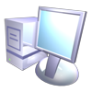
MVC Architecture
Controller
Translates user actions (http requests, Ajax calls, etc.) into application function calls, Works on the model, and selects the appropriate View based on preferences and Model state.
Model
Probably better thought of as a ViewModel – ie the extract of the business data specific for a view.
View
Renders the content of the response (in Html).
CSS is used to turn this content into presentation
Model
Orders
Request
Products
Router
Controller
View
Response: html, xml, JSON, ..
View

Slide 5
Routing
Traditionally URLs map to file names
http://www.mysite.com/default.html
http://www.mysite.com/Login/login.aspx
In MVC URLs are mapped to Actions (Methods) inside Controller (Classes)
http://www.mysite.com/Forum/Index => ForumController.Index()
http://www.mysite.com/Forum/Details/5 => ForumController.Details(int id)
i.e. the Routing Maps URLs to Controller Actions. If we look in Startup.cs we can see this (and the defaults) :
Notes:
Before ASP.NET MVC, URLs in web application mapped to physical files at a disk location. So for example if you had a URL ‘http://www.mysite.com/students/list.aspx’ it simply meant there was a list.aspx file in a ‘students’ folder. The URL had no other meaning. However if this was an MVC site, the URL could look like ‘http://www.mysite.com/student/’. By convention the URL would map to the StudentController class with an action named Index.
The default route takes the first part of a Url path and assumes it contains the name of the controller, it assumes the second part of the URL, if it exists, is the name of an action in that controller. Allowing it to create the controller and invoke the action method inside that controller.

Slide 6
Model
We’re going to need some data (in the Models folder) :
Note how we’ve added an Id – because we intend this to be stored in a database
public class Forum
{
public int ForumId { get;set;}
public string Title { get;set;}
}

Slide 7
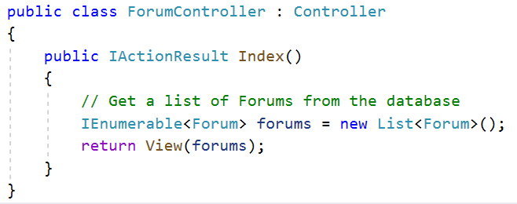
Controller
Controller
Created and invoked by the Router when an HttpRequest is received
Methods inside a controller are referred to has Actions
Router
Returns (default) View
Typically passes a ‘model’ to View
Notes:
The MVC controller is just a class that has inherited from the Controller base class. You add methods to this controller class to implement the functionality of the application. Methods are invoked by requests sent to the controller and are referred to has Actions. It is these Actions that control the interaction between the user and the application. A typical Action would create an appropriate model, select an appropriate view and pass the model into the view when returning.

Slide 8
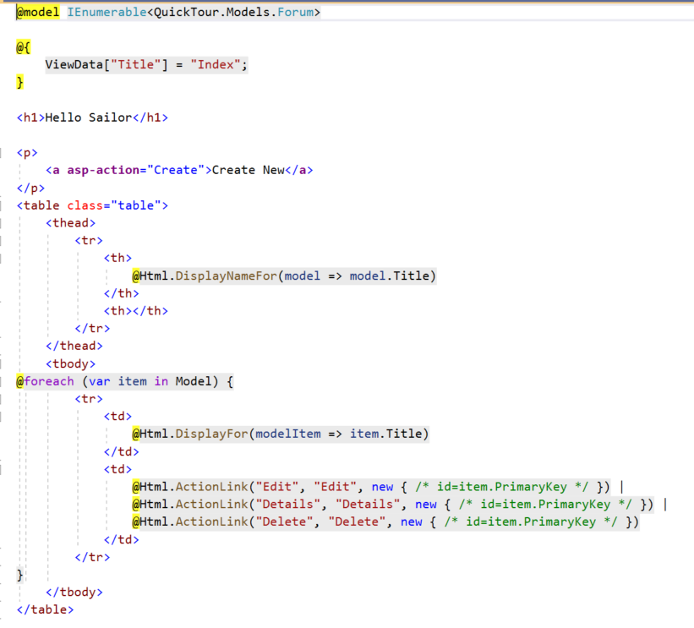
View
Renders the response
Typically HTML with Razor syntax to allow inline C#
View
Response
Controller
References the Model
Notes:
You can use the .aspx or razor rendering engines when defining your views. Typically a view is be made of HTML, CSS, and JavaScript library's.

Slide 9
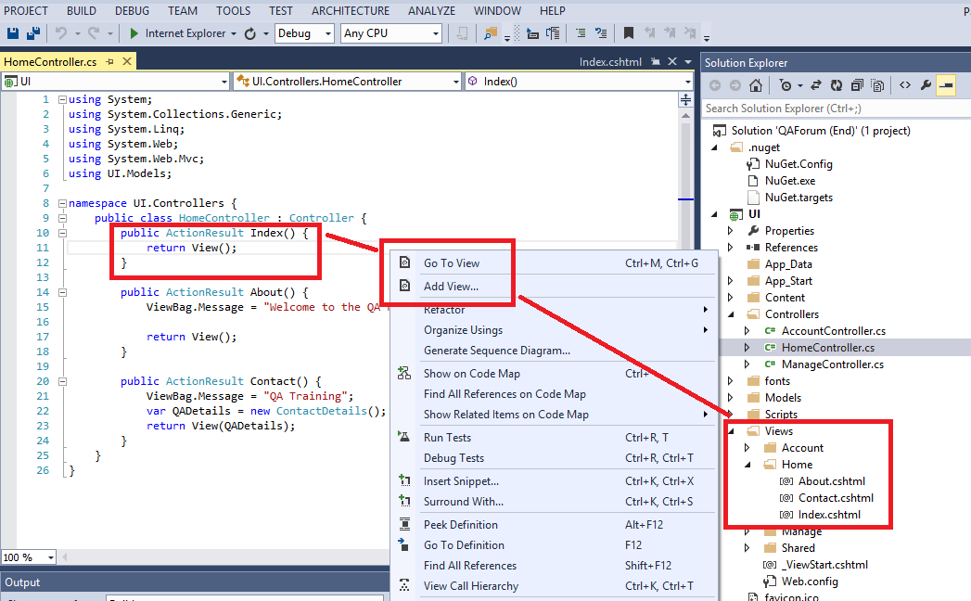
The Default View
Right-click within an action in a controller
The default view will be under Views/<controllerName>/<actionName>.cshtml

Slide 10
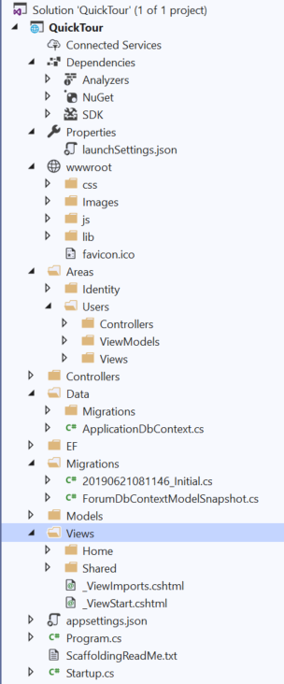

Important folders/files in your application
External Dependencies
Project Profiles
Static Client-Side Files
Separation of functionality
Entity Framework and migrations
Domain Models
Shared Views
Configuration Settings
Startup and Dependency Injection
Notes:
ASP.NET MVC is very “Conventional”.
It assumes that all controllers are post fixed with Controller. E.g. HomeController. Therefore, any routes such as /Home/Index will be routed to the controller named HomeController.
It assumes that all views are located in a folder named after their controller. E.g. Views belonging to HomeController would be located in Views\Home. Views are assumed to be named after the action that returns them. E.g. An action named Create would return a view named Create.

Slide 11
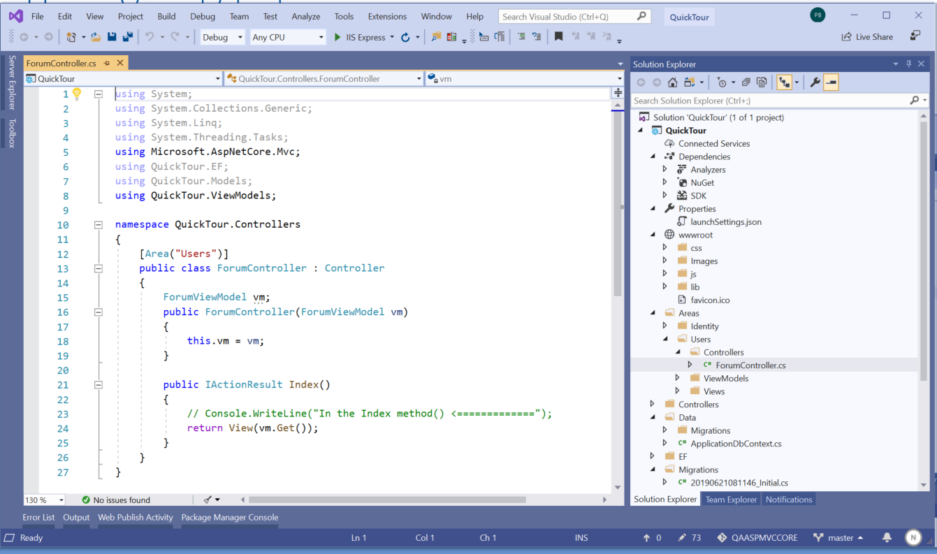
Using Visual Studio
A rich Integrated Development Environment (IDE)
Solution Explorer
The project(s) you are working on
Designer area
The code window
Server Explorer
Database connections
event logs
Team Explorer
Version control
Notes:
Solution Explorer provides you with an organized view of your projects and their files as well as ready access to the commands that pertain to them. A toolbar associated with this window offers commonly used commands for the item you highlight in the list.
The Designer is where you edit your code
The Server Explorer has two main sections, the Data connections section that allows you to create connections to databases and then explore them without leaving the environment. The second is the services area where you can access MSMQ queues, EventLogs, performance counters and other system components.

Slide 12
Chapter Review
Objectives
Gain a high level overview of an MVC application
Chapter content
The MVC Pattern
Routers, Controllers, Models, View-Models, Views and Areas
MVC Project structure
Visual Studio support
Exercise
Create a Starter ASP.NET MVC project in Visual Studio
Notes:
Resources
http://www.asp.net/mvc/tutorials/mvc-5/introduction/getting-started

